Slide 1
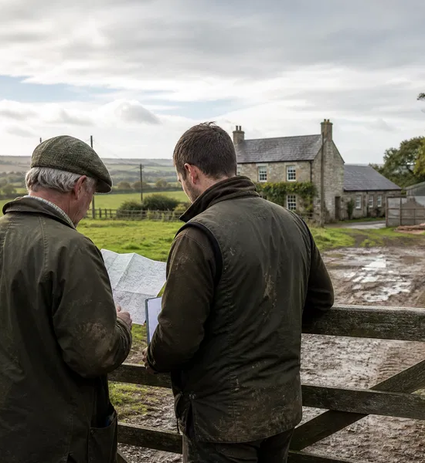
FARMING FORUM CONVERSATION ANALYSIS
Farm succession:
beyond the three-generation myth
What 111 contributions reveal about legacy, choice and control
30 August 2026

Slide 2
A conversation with long horizons
Five days of debate on inheritance, choice and business continuity
4,911
111
392
3.53
TFF views
visible contributions
reactions
average reactions
How to read the findings
The analysis covers all visible original contributions from 26–30 August 2026. Reaction totals are engagement signals, not votes. Sentiment and themes describe this one conversation and should not be treated as a representative survey of British farming.
02 / 10
Source: TFF API conversation 443525

Slide 3




The proverb did not survive scrutiny
Contributors replaced a character judgement with a business diagnosis
THE FAMILIAR STORY
What the conversation added
Debt arrives with the deeds. Valuable land can carry borrowing, tired infrastructure and relatives to compensate.
“One generation builds it.
The next maintains it.
The third loses it.”
Responsibility can arrive before authority. Successors may carry operational pressure without real decision rights.
Timing and luck matter. Interest rates, harvests, market shocks and planning gains can change the outcome.
Memorable — but too simple for the partnership accounts.
Families want different futures. Continuity is not always the same as keeping every acre or enterprise unchanged.
03 / 10
Source: TFF conversation analysis

Slide 4



Succession is more than tax
AHDB puts people, goals and expectations at the centre of the process
People
Goals
Expectations
1
Start early.
Name what each generation wants before assumptions harden.
2
Make authority explicit.
Responsibility without decision rights is not a handover.
3
Bring in evidence.
Use advisers for business, finance, tax and difficult conversations.
04 / 10
Source: AHDB succession planning

Slide 5
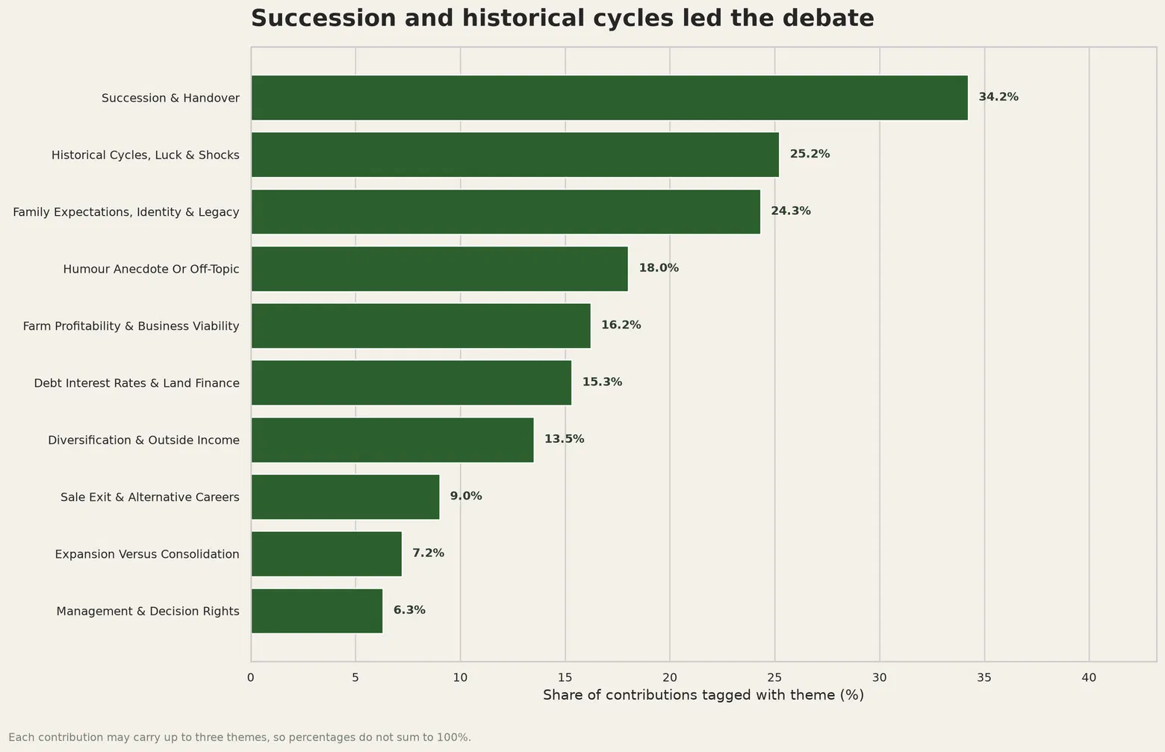
Three themes carried the debate
Succession was central, but history and family identity shaped the argument
What stands out
34.2%
Succession and handover was the largest theme.
25.2%
Historical cycles, luck and shocks complicated easy blame.
24.3%
Family expectations and legacy influenced what “success” meant.
05 / 10
Multi-label themes; percentages do not sum to 100%

Slide 6
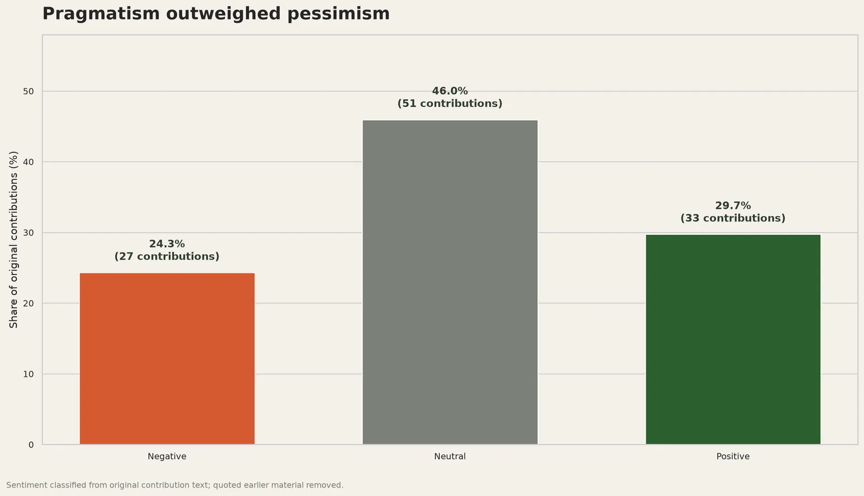
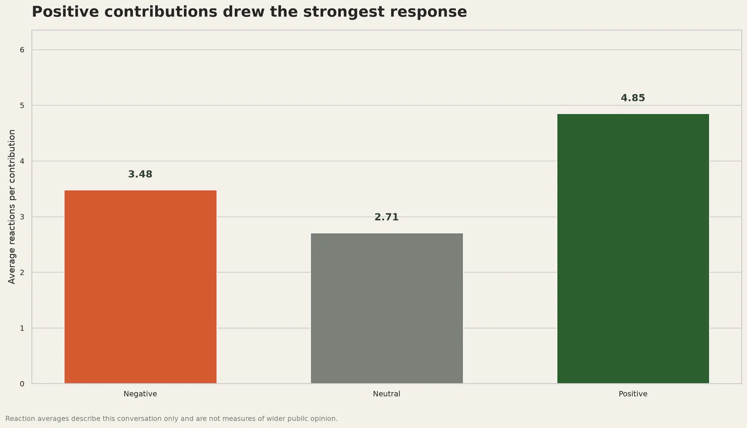
Pragmatism outweighed pessimism
The largest group was neutral — but positive contributions attracted the most reactions
The conversation was not simply a story of decline: choice, resilience and alternative outcomes generated substantial support.
06 / 10
Sentiment classification; reactions are engagement signals

Slide 7


Finance shapes every handover
Debt, decision rights and current relief rules all change the practical options
£2.5m
The business reality
combined 100% APR/BPR allowance per person from 6 April 2026
Do not infer a family’s bill
17 contributions discussed debt, interest rates or land finance.
Relative buy-outs, ageing infrastructure and retirement income can matter as much as land value.
Past decisions must be read against the finance and markets available at the time.
Outcomes depend on ownership, occupation, mortgages, gifts, other assets and business structure.
Government forecasts estimate up to 185 APR-claiming estates may pay more in 2026–27, while around 85% are expected not to pay more because of the reform.
Professional advice is essential.
50% relief applies to qualifying value above the allowance.
Unused allowance can transfer to a surviving spouse or civil partner.
Qualifying tax can be paid over ten annual interest-free instalments.
07 / 10
Source: HMRC guidance and March 2026 policy paper

Slide 8




Keeping every acre is not the only outcome
Contributors separated stewardship from preserving the exact same structure
“
Continue
Consolidate
I want nothing more than my kids to be happy and successful in whatever way works for them.
Transfer ownership and authority into a viable operating business.
Farm fewer acres or enterprises, but improve resilience and quality.
Grey Chap · 18 reactions
“
Diversify
Choose another path
what’s wrong with not expanding? why is it always about more not better?
Use outside income, energy, services or investment to support the holding.
Sell, educate or invest elsewhere when that better serves the family.
Henarar · 9 reactions
08 / 10
Source: TFF contributions 10244683 and 10245833

Slide 9
Authority must move before the paperwork
A practical handover test drawn from the conversation and AHDB guidance
1
Name the decision-makers
2
Test willingness
Define who decides on operations, borrowing, investment and land — and from what date.
Ask whether the next generation genuinely wants the role — not whether everyone assumes they do.
3
Separate needs from assumptions
4
Stress-test the structure
Discuss housing, retirement income, siblings, care and family expectations explicitly.
Review capital, debt, tax, partnership terms and alternative business paths with advisers.
09 / 10
General planning prompts — not personal professional advice

Slide 10
THE CORE LESSON
A handover is a process
1
Start with people and purpose — then address assets, finance and tax.
2
Make assumptions explicit while every generation can participate.
3
Measure success by informed choice and resilience — not acres alone.
SOURCES
“Losing the farm”, The Farming Forum · AHDB succession guidance · HMRC April 2026 Agricultural Relief rules
Conversation findings describe one discussion and are not a representative survey.
10 / 10

