Slide 1
Farm visit wins cautious welcome
What 162 Farming Forum contributions reveal about trust, delivery and the £65 million drought package
TFF News
26 August 2026

Slide 2
Engagement was noticed, not banked
CONTRIBUTIONS
TFF VIEWS
REACTIONS
AVERAGE ENGAGEMENT
162
4,568
276
1.70
15–19 August
Authoritative API count
Across all contributions
Reactions per contribution
Conversation window: Friday 15 August → Tuesday 19 August 2026
THE CENTRAL SHIFT
The question moved from who visited? to what will be delivered?
Source: TFF Read API; deterministic conversation analysis.
2

Slide 3
The package combined cash and flexibility
Measure | Scale / timing | Practical change | Delivery test
SFI26 Window 2 | +£50m £290m total | More budget for new agreements; window due to open in September. | Application access and payment timing for farms under current pressure.
Water storage | Up to £15m Autumn launch | Grant support for on-farm reservoirs serving crop irrigation. | Eligible items, grant rates and planning alignment.
ELM flexibility | Available during drought status | Cutting, grazing, firebreaks and delayed establishment without losing payments. | Clear county status, usable guidance and timely approvals.
Water access | Immediate and from September | Faster temporary abstraction changes and simpler long-duration reservoir licensing. | Whether permissions arrive when water is actually needed.
The argument was not whether help was welcome. It was whether budgets, rules and dates would convert into usable support.
Sources: Defra Farming Blog; BBC News; Guardian reporting.
3

Slide 4
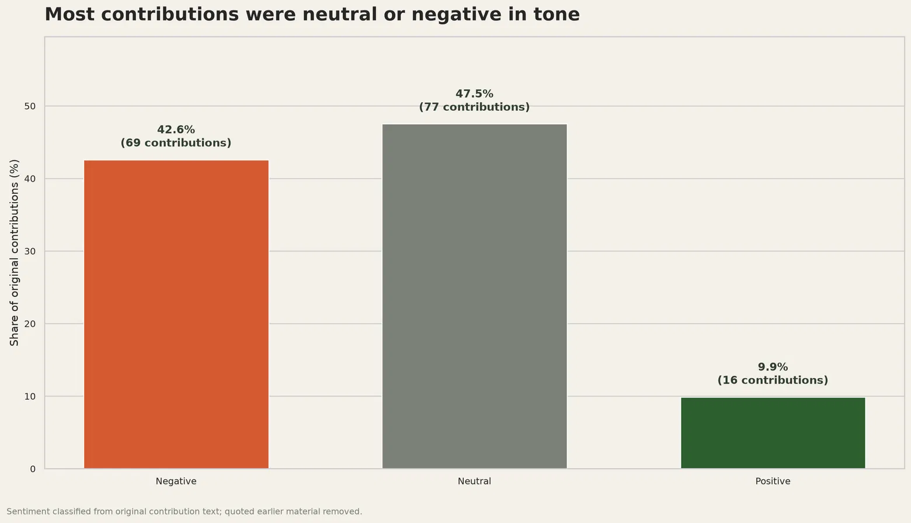
Neutral analysis sat beside strong scepticism
42.6%
Negative — 69 contributions
47.5%
Neutral — 77 contributions
9.9%
Positive — 16 contributions
Positive contributions drew the highest average reactions, but remained a small minority. The overall tone was cautious rather than celebratory.
Source: TFF contribution-level classification using gpt-5-mini; deterministic aggregation.
4

Slide 5
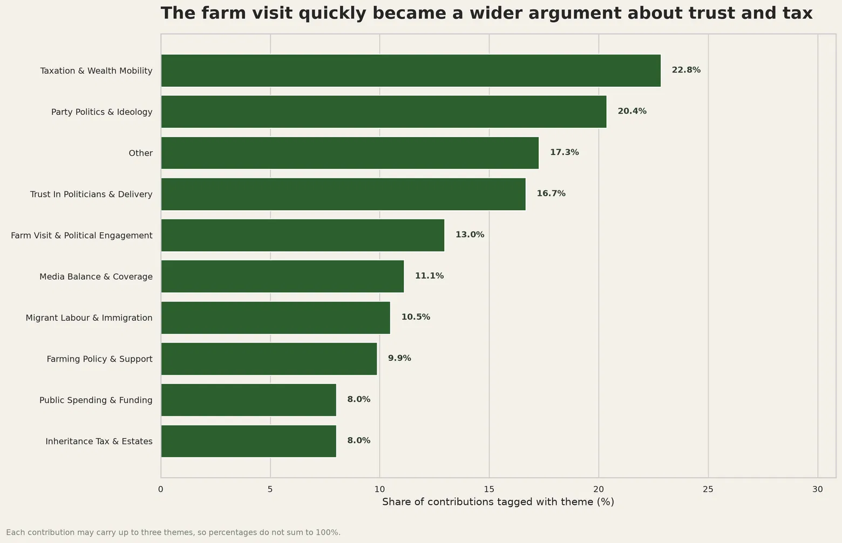
The debate moved rapidly beyond drought
THE EDITORIAL SHIFT
The visit became a proxy for a much wider trust argument.
22.8% — taxation and wealth mobility
20.4% — party politics and ideology
16.7% — trust and delivery
13.0% — the farm visit itself
Multi-label themes: one contribution may carry up to three tags, so shares do not total 100%.
Source: TFF contribution-level classification; percentages calculated across 162 contributions.
5

Slide 6
A few voices sustained much of the exchange
REACTIONS AMONG LEADING VOICES
Contributor | Reactions
Properjob | 45
Clive | 32
BrianV | 21
Bury the Trash | 15
Volume and approval were not the same thing.
Properjob contributed fewer entries than Clive but received the highest reaction total.
Source: TFF Read API. Screen names shown exactly as supplied; no claim of representativeness.
6

Slide 7
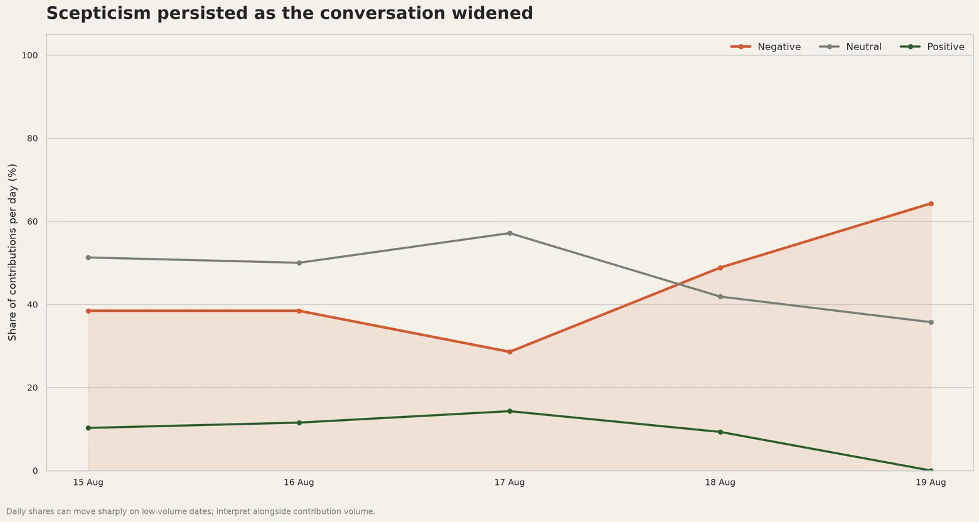
Tone hardened as the conversation widened
THE INFLECTION
Neutral discussion gave way to sharper political argument.
15–17 Aug
Neutral tone remained above negative tone.
18 Aug
Negative contributions became the largest share.
19 Aug
Negative tone reached 64%; positive tone fell to zero.
Source: TFF contribution-level sentiment classification. Daily shares can move sharply on lower-volume dates.
7

Slide 8
The spectrum ran from encouragement to proof
CAUTIOUS ENCOURAGEMENT
EARLY OPTIMISM
“Any signs of understanding are to be encouraged.”
Burnham appeared “more sympathetic and receptive to farmers”.
Properjob · TFF contribution
Andy26 · TFF contribution
THE DELIVERY TEST
THE INDUSTRY RESPONSE
Politicians can “talk the talk” but few “can walk the walk”.
“A really welcome start” — but not a solution to the immediate crisis.
Still Farming · TFF contribution
Tom Bradshaw · NFU president, quoted by BBC News
Sources: TFF contribution links; BBC News. Quotations checked against original source wording.
8

Slide 9
Trust now depends on administration
SEPTEMBER 2026
AUTUMN 2026
ONGOING DELIVERY
SFI Window 2
Water Management Grant
Planning and abstraction
Opening date, application access and payment timing will show whether the extra £50m reaches farms under pressure.
Eligible investments, grant rates and the application process will determine the practical value of up to £15m.
Clear rules and timely permissions must arrive when farms need to secure and store water.
Turning up was noticed. Trust will be measured in functioning schemes and farms still trading next summer.
Read the full conversation on The Farming Forum
Sources: Defra Farming Blog; BBC News; TFF conversation analysis.
9

