Slide 1
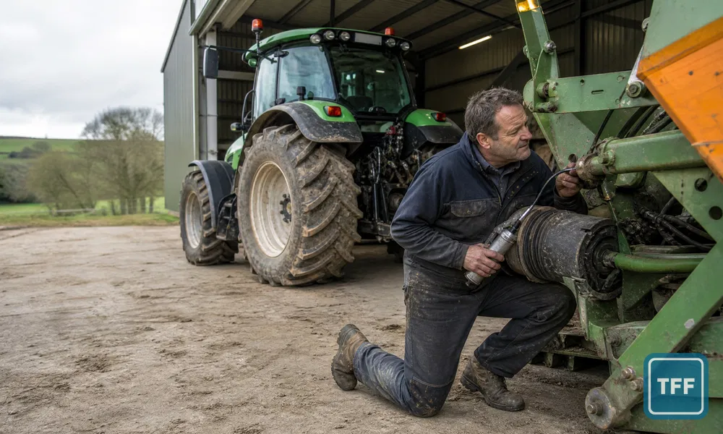
Design it for the person underneath
What 115 contributions reveal about machinery access, controls and operator trust
TFF News · 29 August 2026

Slide 2
Small decisions, daily consequences
6,405
TFF views
115
contributions
376
reactions
3.27
reactions per contribution
The recurring problem was not technology itself.
It was the gap between a design that works on paper and the daily reality of servicing, cleaning and controlling it.
Six days of field evidence
The conversation ran from 8 to 13 August 2026 and covered tractors, combines, PTOs, loaders, brakes, cabs and service points.
Examples remain attributed operator experiences, not verified product-defect findings.
Source: TFF read API metadata and contribution-level analysis
2

Slide 3
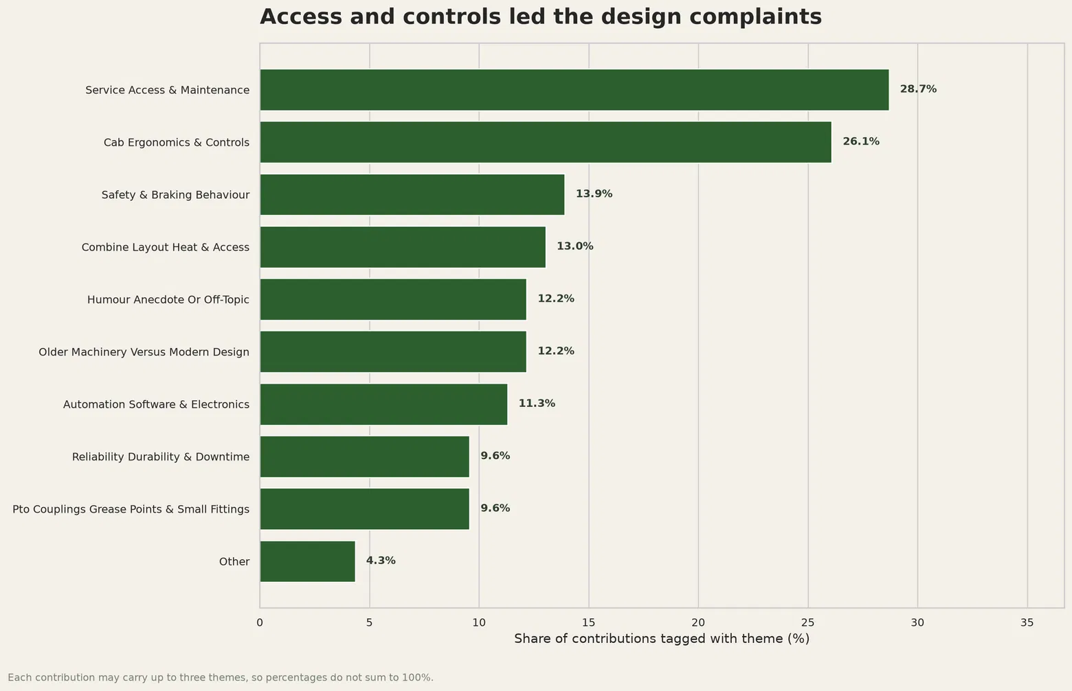
Access and controls lead
Share of 115 contributions
28.7%
Service access & maintenance
26.1%
Cab ergonomics & controls
13.9%
Safety & braking behaviour
Themes overlap; each contribution could carry up to three labels.
Source: contribution-level multi-label classification; quoted earlier material removed
3

Slide 4



The grease nipple test
38
reactions
Grease point facing inwards
“Pto shafts assembled with the grease nipple on the inside of the uj...”
— David1968
37
reactions
Pull back while pushing on
A PTO collar criticised for opposing the motion needed to fit the shaft.
— Lofty1984
23
reactions
Upside-down oil filters
“Why just why”
— Welgerbaler
Minor access decisions become repeated costs when they are met at every service.
Source: attributed TFF contributions and reaction counts
4

Slide 5
Controls must work in the job
Field conditions
Design requirements
Gloves and dirty hands limit precise touchscreen use.
Dust and vibration challenge small targets and hidden menus.
Changing implements demands quick, predictable setup.
Pressure and fatigue make delayed responses harder to interpret.
Essential functions remain available through tactile controls.
Labels and states are visible without menu hunting.
Automatic behaviour is consistent and easily overridden.
Failure modes are obvious, safe and recoverable.
“I much prefer dials, levers and buttons cos they work no matter what your hands are covered in.”
— zero
Source: attributed TFF contribution; design requirements are editorial synthesis
5

Slide 6

Irritation can become risk
1
Awkward access or unclear behaviour
A fitting, control or service point resists normal work.
HSE design principles
Provide safe and reliable control systems.
Reduce routine access to danger zones for maintenance or cleaning.
Clearly mark controls and ensure stopping devices work correctly.
Use Safe Stop before maintenance or adjustment.
2
Workaround pressure grows
Operators improvise access, delay maintenance or distrust automation.
3
Perceived safety concern
Braking, locking or unexpected control logic can raise the stakes.
Product-specific accounts are attributed contributor experiences and have not been independently tested.
Sources: TFF conversation; HSE machinery design and safe-use guidance
6

Slide 7
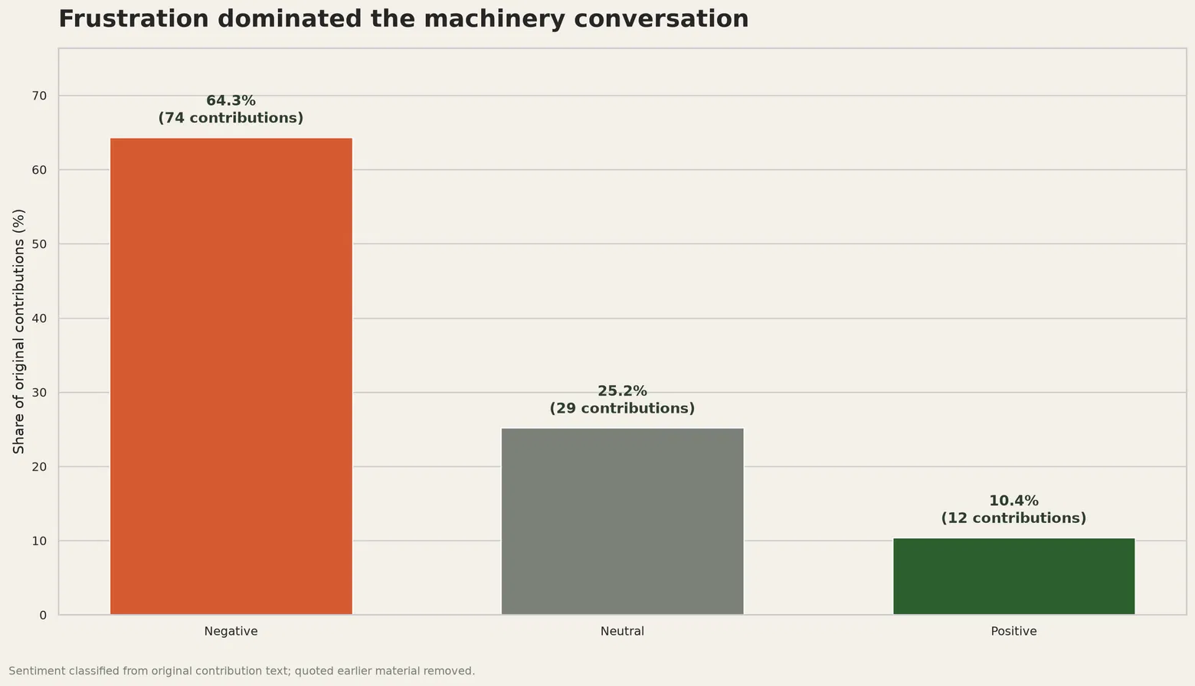
Frustration dominated
Average reactions
3.91
Negative
1.90
Neutral
2.67
Positive
Sentiment describes this conversation only, not UK farmers generally.
Source: structured contribution-level sentiment classification and deterministic aggregation
7

Slide 8
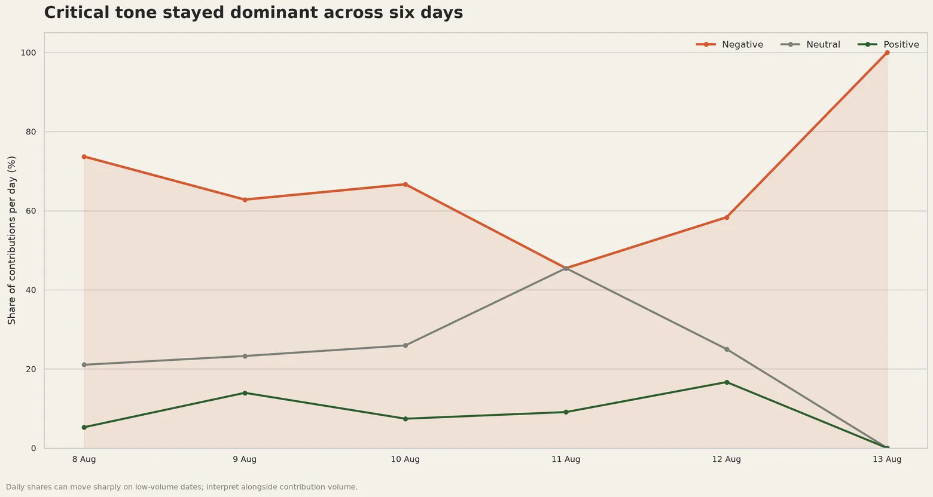
Critical tone persisted
Five of six days
Negative tone exceeded both neutral and positive contributions.
100% on 13 Aug
The final day contained very few contributions, so the share moved sharply.
Validated output
No contribution fell below 0.60 classification confidence.
Source: daily sentiment shares; interpret alongside contribution volume
8

Slide 9
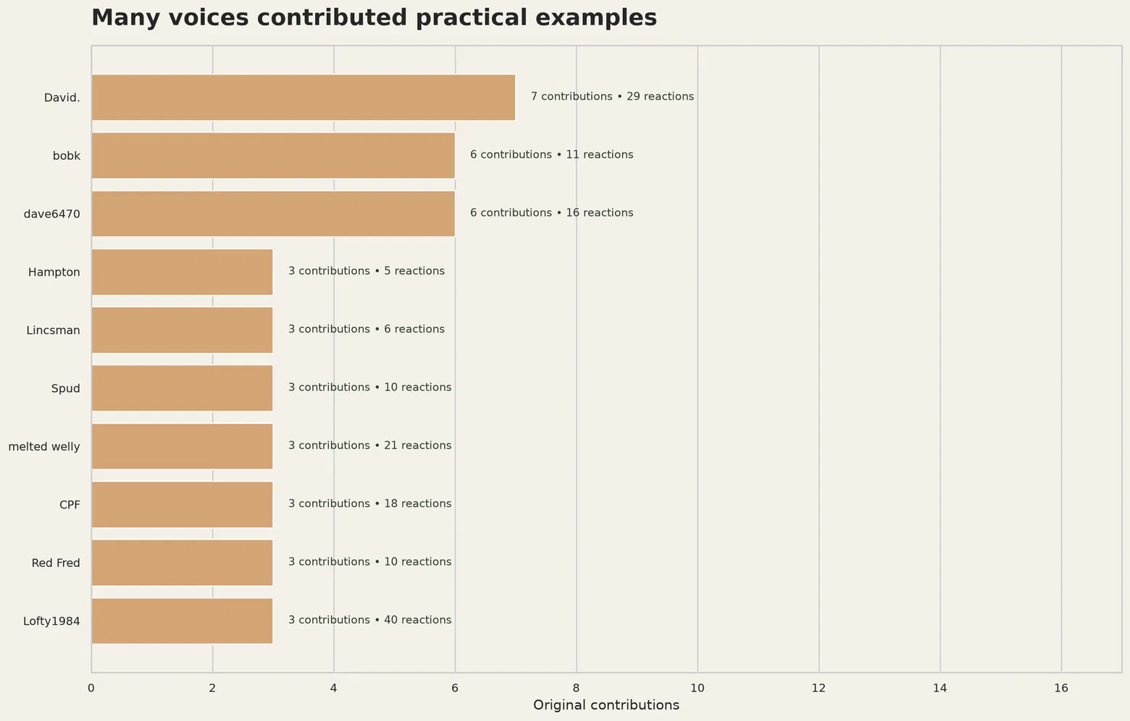
A broad operator evidence base
Highest volume
7
David.
29 reactions
Highest reactions among the ten most active voices
40
Lofty1984
across 3 contributions
Activity shows breadth of examples, not representative industry opinion.
Source: TFF contribution counts and reaction totals; screen names preserved
9

Slide 10
Turn complaints into a design brief
01
Bring operators in early
Include operators, service engineers and contractors before layouts are fixed.
02
Test real maintenance access
Use real tools, gloves, mud, poor light and realistic time pressure.
03
Protect essential controls
Keep critical functions clear, tactile and available when screens fail.
04
Close the feedback loop
Treat repeat workarounds and service complaints as design data.
The design is not finished until the person underneath can live with it.
Read the full conversation on The Farming Forum
Source: TFF operator experiences and HSE design principles
10

