Slide 1
The real cost of farm wheels
Vehicle prices, tax and input pressure through 123 TFF contributions
TFF News · Conversation analysis
27 August 2026
Agricultural business intelligence

Slide 2
One claim triggered a wider cost debate
Conversation activity · 10–16 August 2026
123
4,668
323
2.63
visible contributions
TFF views
reactions
average reactions
How the conversation widened
01
02
03
04
Honda price claim
Japan · US · UK
Tax and services
What public spending buys
Pickups and tractors
Business-use realities
Farm-input pressure
Costs and confidence
Source: TFF read API metadata and normalized contribution record.
02 / 09

Slide 3
Advertised prices were not like-for-like
OPENING CONTRIBUTION · UNVERIFIED COMPARISON
What the comparison did not establish
Market | Claimed on-road price
Japan | £19,350
United States | £24,000
United Kingdom | £35,000
01 Exact model year and market specification
02 Exchange-rate date and finance incentives
03 Local tax, registration and delivery treatment
04 Warranty, compliance and distribution differences
Useful question, incomplete evidence: compare the delivered, tax-adjusted cost—not the first advertised figure.
Sources: TFF contribution 10229884; GOV.UK vehicle tax guidance; HMRC VAT Notice 700/64.
03 / 09

Slide 4
Farm costs made the concern credible
Official agricultural price evidence · March 2026
+3.7%
−5.3%
+1.1%
Agricultural input prices
year on year
Agricultural output prices
year on year
Agricultural input prices
month on month
What Defra’s index covers
What the evidence does—and does not—show
Consumed inputs: fertiliser, seed, feed and fuel
Investment inputs: tractors, machinery and buildings
It supports concern about tighter margins and higher working-capital needs.
It does not prove that every overseas vehicle price is directly comparable with a UK quotation.
Sources: Defra Agricultural Price Index; AHDB analysis published 17 June 2026.
04 / 09

Slide 5
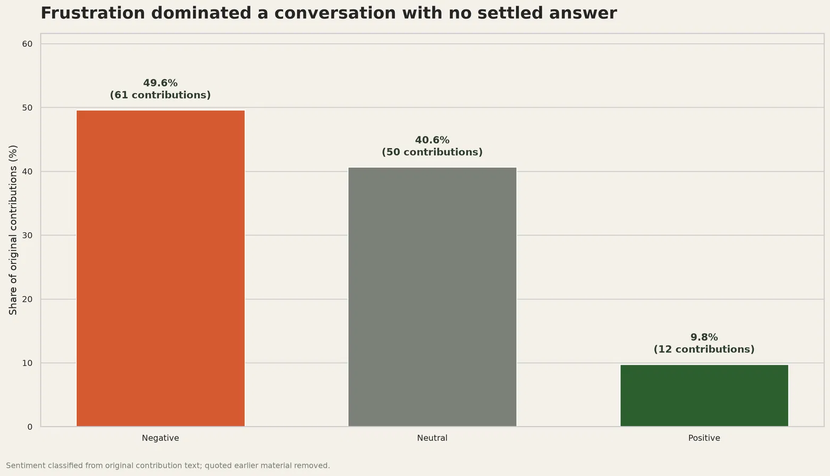
Frustration outweighed optimism
Sentiment of original contribution text
61
negative contributions
3.77
average reactions on
negative contributions
Interpretation
This describes the tone of one conversation—not the views of farmers generally.
Source: Structured classification of 123 original TFF contributions.
05 / 09

Slide 6
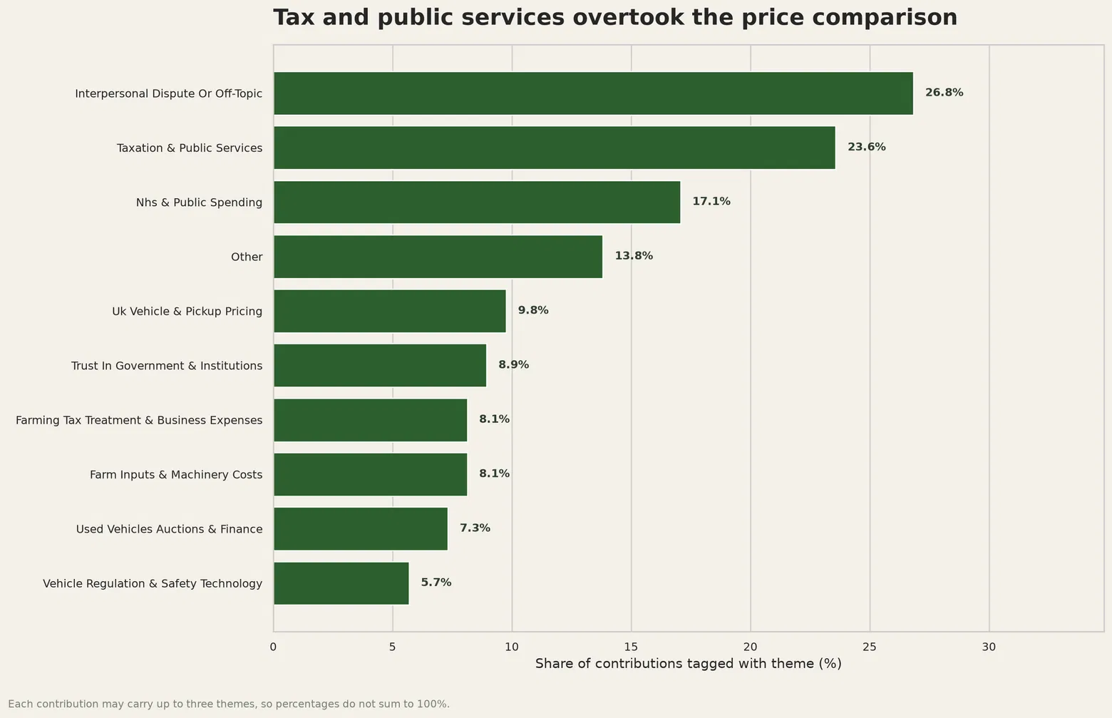
The conversation moved away from cars
Multi-label theme prevalence across original contributions
26.8%
interpersonal dispute or off-topic
23.6%
taxation and public services
Farming relevance
Vehicle and pickup pricing: 9.8%
Farm inputs and machinery: 8.1%
Source: Structured multi-label classification; contributions may carry up to three themes.
06 / 09

Slide 7
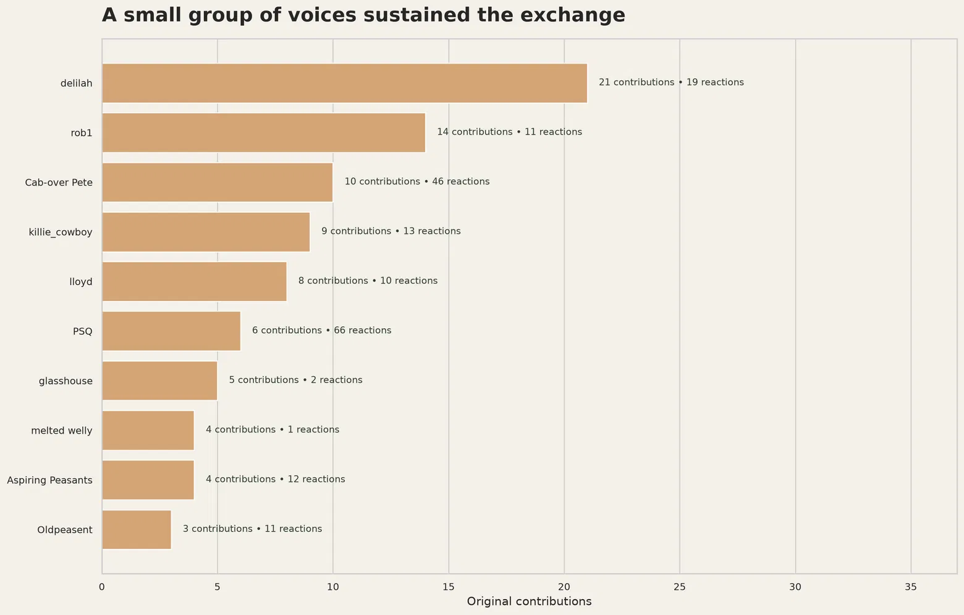
A small group sustained the exchange
Top voices by original contribution volume
21
delilah contributions
19 reactions
66
PSQ reactions
from 6 contributions
46
Cab-over Pete reactions
from 10 contributions
Source: TFF contribution counts and reaction scores; activity does not imply representativeness.
07 / 09

Slide 8
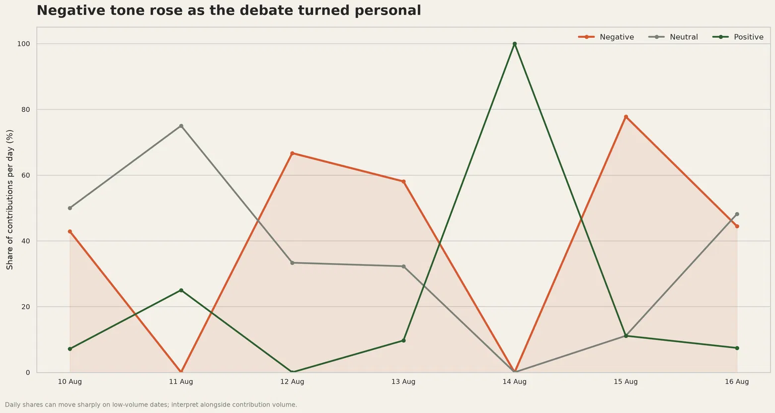
Tone swung sharply by day
Daily sentiment shares · interpret alongside contribution volume
11 Aug
Neutral contributions dominated
15 Aug · 77.8% negative
The argument became more personal
14 Aug · one contribution
The 100% positive point is low-volume
Source: Structured daily sentiment aggregation of original TFF contribution text.
08 / 09

Slide 9
Compare the delivered cost
A practical buying checklist for farm vehicles and machinery
Check | What to establish
Specification | Model year, engine, payload, equipment and warranty
Taxes and fees | VAT or sales tax, registration, delivery and first-year VED
Business treatment | Car or commercial-vehicle classification, private availability and VAT recovery
Finance | Exchange rate, incentives, interest, residual value and total ownership cost
RULE OF THUMB
The cheapest figure on screen is not the farm-account cost.
Price differences may reflect tax and regulation—but also currency, competition, finance and market positioning.
Read the full conversation on The Farming Forum
TFF News · Conversation analysis · 27 August 2026
09 / 09

