Slide 1
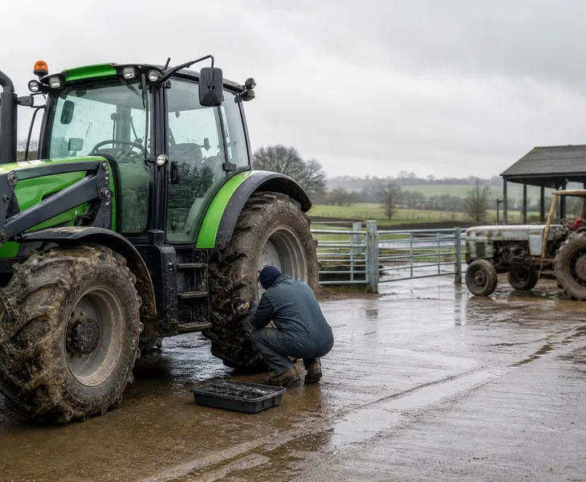
Tractor reliability:
match the system to the job
What 116 farming contributions reveal about brakes, duty cycles and support
TFF News · 31 August 2026
Conversation analysis · The Farming Forum

Slide 2
A practical conversation, not a brand survey
4,231
116
231
1.99
TFF views
visible contributions
total reactions
reactions per contribution
What it tells us
What it does not tell us
Which operational concerns drew the most attention
How farmers linked machinery, trailers, operators and service support
Where safety and maintenance guidance sharpen the discussion
No representative reliability rate for UK tractor fleets
No manufacturer ranking or proof of sector-wide defects
No substitute for competent servicing or legal roadworthiness checks
Source: TFF read API; conversation 443716; analysis covers all visible contributions
2

Slide 3
The trigger was repeated downtime
“Are we just unlucky or are modern tractors not designed for working on livestock farms?”
System | Experience described
Brakes | Wear and repair concerns
Electrics | Repeated warning or fault issues
Hydraulics | Leaks and operational downtime
Emissions | AdBlue and aftertreatment faults
Engine | A serious concern under investigation
Opening contribution · Frank-the-Wool
The contrast
The boundary
An elderly Landini was still available while newer machines were out of action—an image that gave the conversation its force.
These are attributed experiences. They identify operational questions; they do not establish manufacturer-wide failure rates or technical causation.
Source: TFF contribution 10246391; reported experiences are not independently verified defects
3

Slide 4
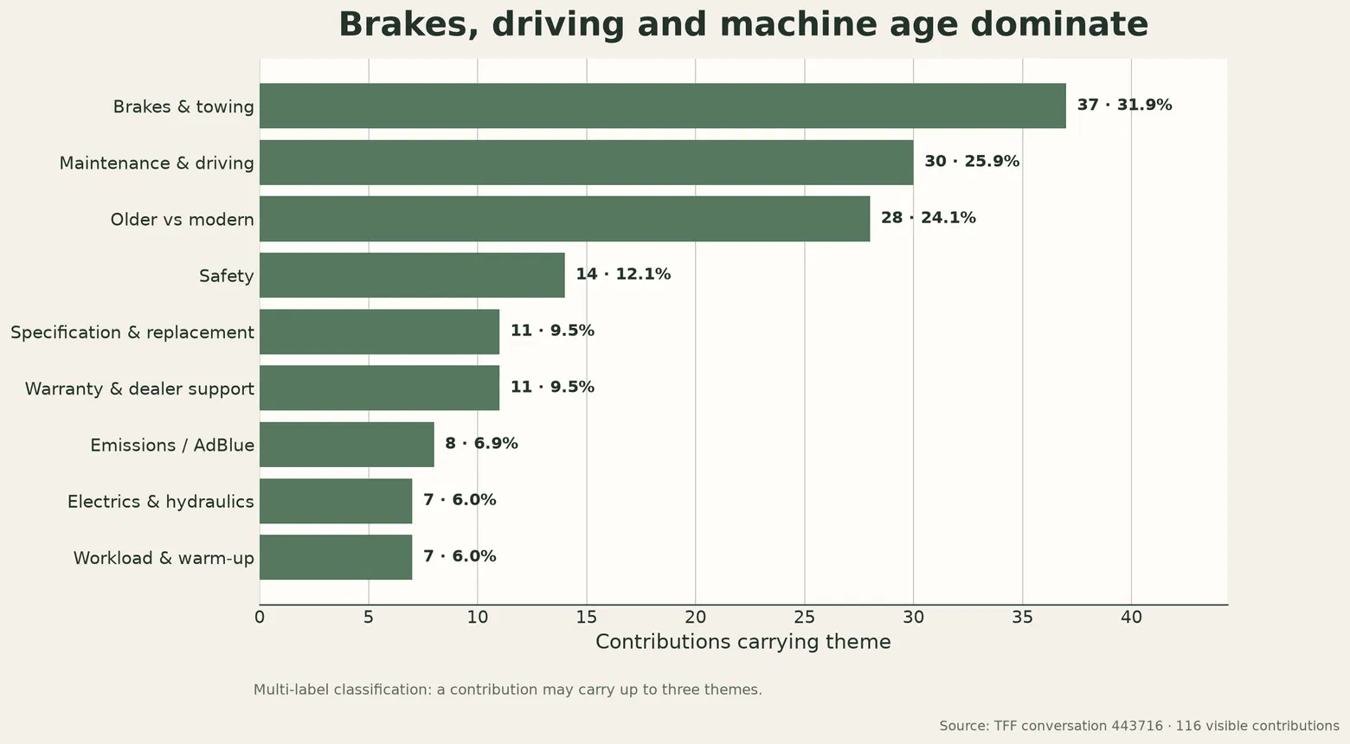
Brakes and towing dominate
What farmers connected
Trailer compatibility and tractor brake life
Operating speed and downhill technique
Maintenance condition and driver practice
HSE
NFU / BAGMA
IMPLICATION
Safety-critical brakes and steering must be efficient and maintained.
Trailer brakes must suit the intended weight and speed.
Assess the tractor and trailer as one braking system.
Sources: TFF contribution classification; HSE; GOV.UK; NFU/BAGMA trailer guidance
4

Slide 5
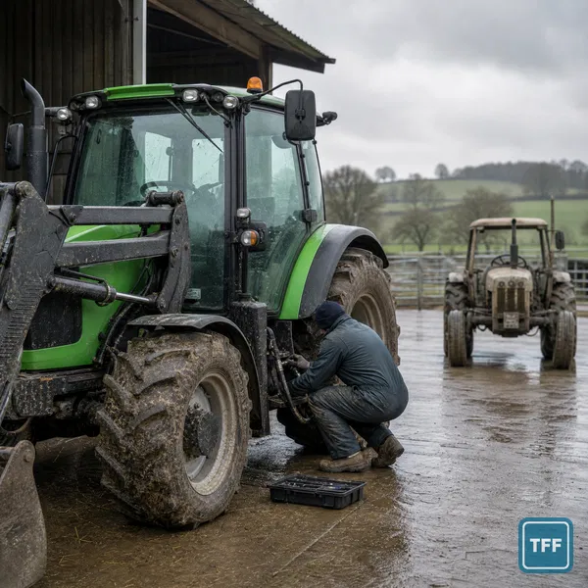
Livestock work creates an awkward duty cycle
01
Short jobs may limit sustained warm-up and engine load.
02
Mud and moisture raise contamination and connection risks.
03
Frequent attachment changes increase hydraulic and handling demands.
04
Several operators can produce different driving and checking routines.
ANALYTICAL BOUNDARY
These are operational hypotheses raised by participants—not proven causes of sector-wide tractor faults.
Source: TFF conversation 443716; original TFF News editorial image
5

Slide 6
Reliability includes the response
“They all break, it is how you are looked after when they do that matters.”
11
contributions addressed warranty or dealer support
T C · contribution 10246696
9.5% of the conversation; multi-label classification
Dealer response capacity
Farm contingency capacity
Capable technician availability
Parts and diagnostic access
Replacement tractor while repairs continue
Backup machine or hire arrangement
Clear service and warranty terms
Downtime plan for daily feeding and handling
Source: TFF conversation 443716; warranty/dealer-support classification
6

Slide 7
Older versus modern is not binary
Decision factor | Older / simpler machine | Newer / more complex machine
Repairability | Independent support and simpler diagnosis may appeal | Specialist diagnostics and dealer access may be important
Availability | Clean examples can be scarce and expensive | New supply and warranty routes are clearer
Operating risk | Age-related wear and parts scarcity remain | Electronic and aftertreatment downtime may concern users
Working environment | Useful as a backup or for limited tasks | Comfort safety and productivity can be stronger
Best question | Can the farm maintain it safely and economically? | Can the support system keep it productive?
KEY TAKEAWAY
Age is a proxy; duty-cycle fit, maintenance and support determine the operating result.
Source: TFF conversation 443716; older-versus-modern theme appeared in 28 contributions
7

Slide 8
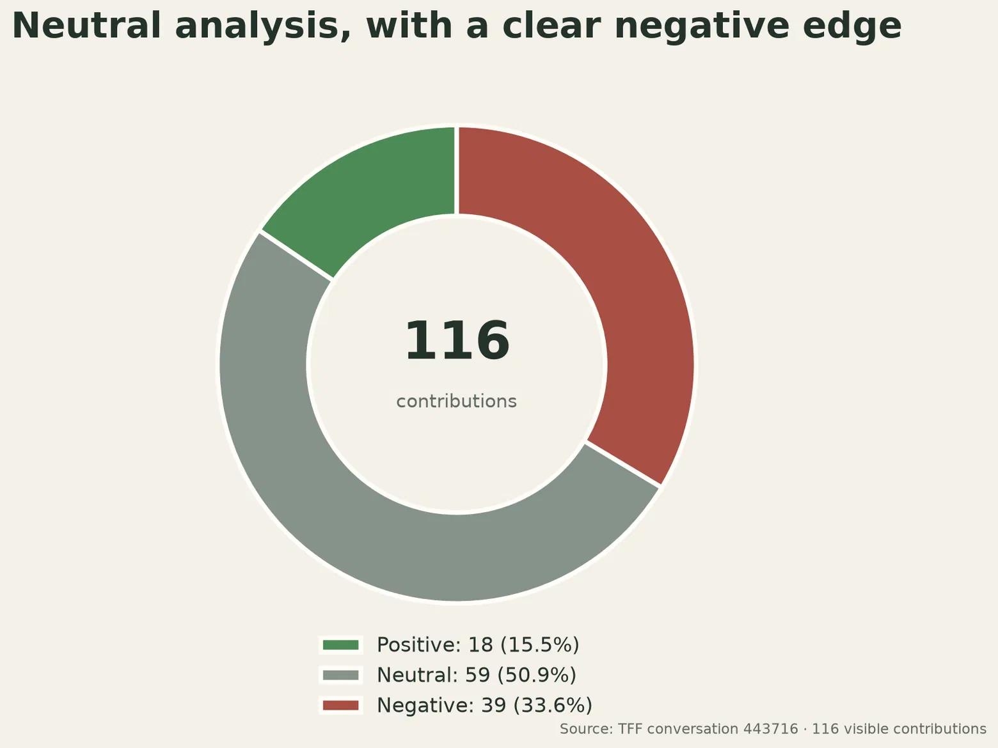
Concern was mixed with diagnosis
50.9%
neutral wording
33.6%
negative wording
15.5%
positive wording
2.18
average reactions on negatively worded contributions
This is a language classification of one conversation—not a satisfaction score or manufacturer ranking.
Source: structured classification of all 116 visible contributions; mean confidence 0.808
8

Slide 9
Operator voice sharpened the safety message
“Go down the hill the same speed you can go up it.”
marco · the conversation’s most-reacted contribution
HSE
GOV.UK
NFU / BAGMA
Brakes and steering are safety-critical. Preventative maintenance and competent repair are essential.
Owners remain responsible for roadworthiness even where an agricultural tractor is exempt from periodic testing.
Trailer brakes must be compatible with intended weight and travel speed to avoid overworking the tractor system.
EMISSIONS SYSTEMS
Unverified removal or disabling advice is not endorsed; follow legal and manufacturer requirements.
Sources: TFF contribution 10247099; HSE; GOV.UK; NFU/BAGMA
9

Slide 10
The design brief is a complete system
01
02
03
04
Specify for the duty cycle
Couple tractor and trailer
Standardise operator practice
Buy support capacity
Match tractor size, controls, hydraulics and emissions package to short livestock jobs and sustained road work.
Match brakes, weight, operating speed and compatibility rather than assessing either machine alone.
Use consistent daily checks, driving expectations, maintenance intervals and defect reporting across every operator.
Secure capable technicians, parts routes, warranty clarity and a realistic backup plan for daily livestock work.
Design it for the job. Maintain it as one system.
Synthesis: TFF conversation analysis; HSE; GOV.UK; NFU/BAGMA
10

